Slide 1
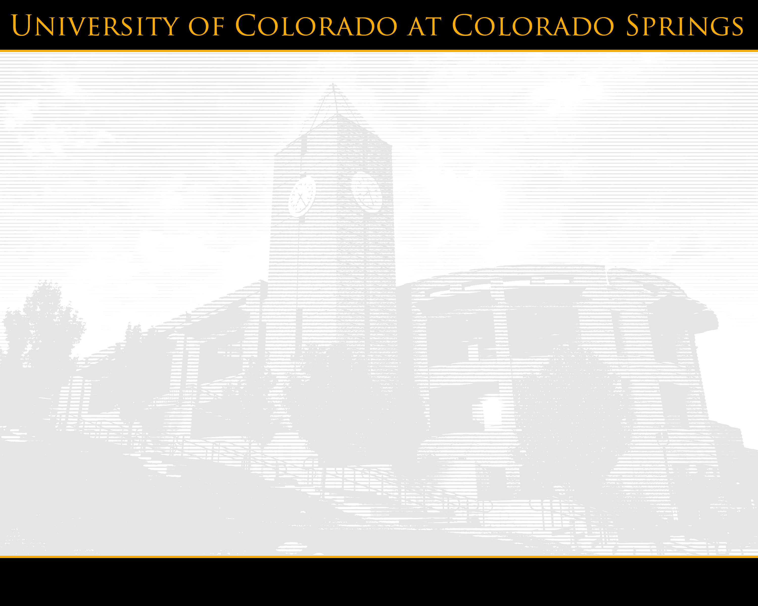

Year in Review
Deans, Directors and Department Chairs
May 6, 2009

Slide 2



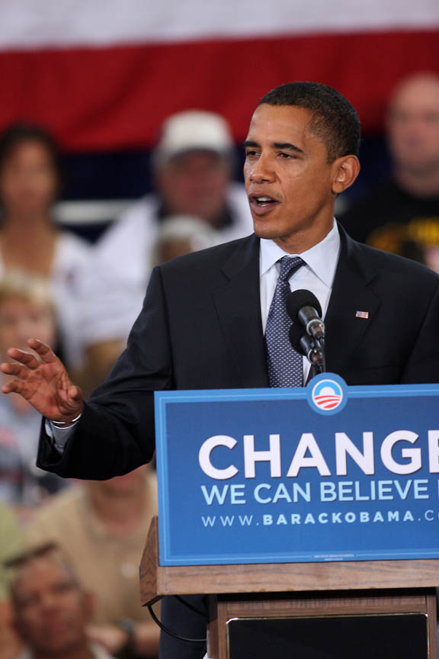
July
Colorado Springs Business Journal award
9 hours “no charge” benefit
Academic Affairs leadership
Presidential candidate visit
Campus remembers Jackie Beyer and Denys Volan
Notes:
Readers of the Colorado Springs Business Journal voted the UCCS as having the best business school in Colorado as well as the best place to earn a master’s of business administration degree.
UCCS Pilot Program allows faculty, staff and dependents to take up to nine hours at no charge.
Jenenne Nelson begins as dean of graduate school; Michael Larson as associate vice chancellor for research and innovation.
Science and Engineering reaches milestone of 50%
Jacquelyn “Jackie” Beyer. A campus memorial service is planned at a later date for Jacquelyn “Jackie” Beyer, professor emerita. Beyer, who came to UCCS in 1970 and helped to found the Geography and Environmental Studies Department, died July 22.
Denys Volan. A retired faculty member whose tenure with the university preceded the founding of UCCS died July 15. Denys Volan directed the Colorado Springs Extension Program 1952-1955 and coordinated evening classes at military installations, at Memorial Hospital, and in District 11 buildings, before the campus was formed. He later taught history at UCCS, retiring in 1980

Slide 3


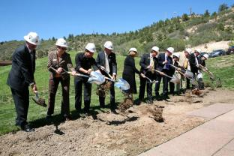
August
U.S. News and World Report ranking
Event Center construction underway
262 becomes 255
Olympic fever
Convocation
Notes:
The undergraduate engineering program at UCCS is among the best in the nation and the entire university is among the best public universities in the Western United States, according to the editors of U.S. News and World Report.
In the 2009 college rankings edition, “America’s Best Colleges,” released Aug. 25, the magazine’s editors ranked the UCCS undergraduate engineering program tenth in the nation among public engineering schools offering bachelor’s or master’s degrees. The magazine’s editors ranked the overall quality of UCCS sixth among public master’s degree-granting Western universities.
Ground broken on event center aug. 21 – first of deep dig
Decision to move to 255 as campus runs out of 262 extensions.
Olympic fever. Alum Matt Emmons earns silver in shooting. Current student Adam Wheeler earns bronze in wrestling. 10 others with UCCS ties (alums, current students, former students) participate
Convocation tradition returns with Gus Lee and coverage in NY Times of freshman seminar

Slide 4
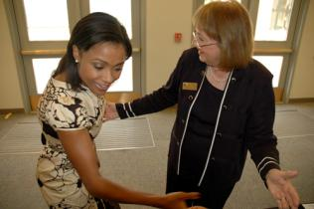
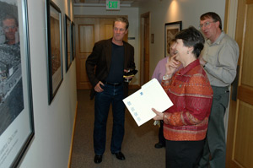
September
Carole Schoffstall
Sally Ride and “Awesome Dawesome” visit
Austin Bluffs bridge opens
Historic photo display
Enrollment reaches 8,000
Steel and Silver Series
Private support
Notes:
Carole Schoffstall feted for 17 years of leadership of Beth el
Sally Ride – first woman in space – and Dominique Dawes (first African American to win gold in gymnastics) visit to inspire
Austin Bluffs bridge opens – finally – no more excuses for being late to class
Historic Photo Display – joint effort between University Relations and Library – opens in Main Hall. Invite to visit (pictured are Randy Kouba, Antoinette Massengale, who took some of the photos, and Tom Christensen)
Steel and Silver Series with CSU Pueblo – excitement about Ent Sponsorship, sports rivalry
Private support – Reisher Scholarship for transfer students, Jerry McMorris gift (WSJ subscriptions)

Slide 5
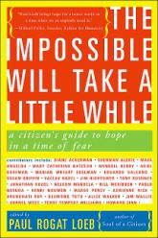
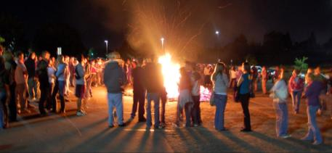
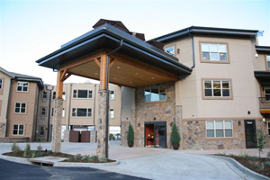
October
Palisades at Broadmoor
Paul Loeb visits
Back to Bluffs
Honors Program approved
Hiring reviews begin
Notes:
Palisades opens – public/private partnership. Beth el, psychology, others involved.
Paul Loeb – author of impossible will take a while – visits to give civic literacy message
Back to Bluffs features bonfire, record crowd
Honors Program approved, Mike Hackman to lead
Hiring reviews – precursor of budget problems to come …

Slide 6
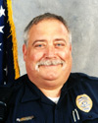
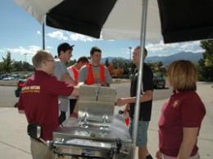

October (continued)
Officer Craig Highline
Science bonds sold
“Haze” shown on campus
UCCS radio
University Advancement division
“Good humor” ice cream visit
Alumni Relations • Events • Federal & State Government Relations
Internal Communications • Marketing • Media Relations • Real Estate Projects
Notes:
Craig Highline killed in off-campus accident. Community support tremendous
Bonds - $17 million – sold to finance renovation of Science
Haze shown on campus as part of alcohol education efforts, a necessary part of having traditional undergrads on campus
UCCS radio – it’s web radio – gets permanent home in IT
Advancement division launched (University Relations, Alumni, Special Events) under Martin Wood leadership
Parking department buys bicycle and distributes ice cream as part of image campaig

Slide 7
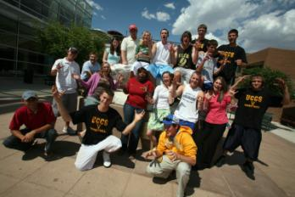
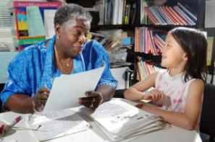
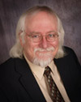
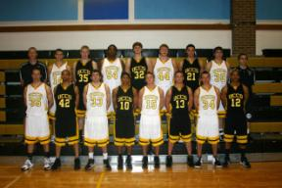
November
Colorado Health Foundation
Education accreditation
Record student retention
Mountain Lions on TV
Distinguished Professor Tom Pyszczynski
Notes:
Colorado Health Foundation funds 467,000 three year grant to integrate mental and physical health
Education receives seven year accreditation for teacher ed program (highest)
Student retention hits 70% (record). Explain retention is helping but not keeping people who don’t earn right to be here.
Mountain Lions televised on comcast 20 by own media services department
Tom P recognized as only second distinguished professor in UCCS history (Dan Couger was other)

Slide 8
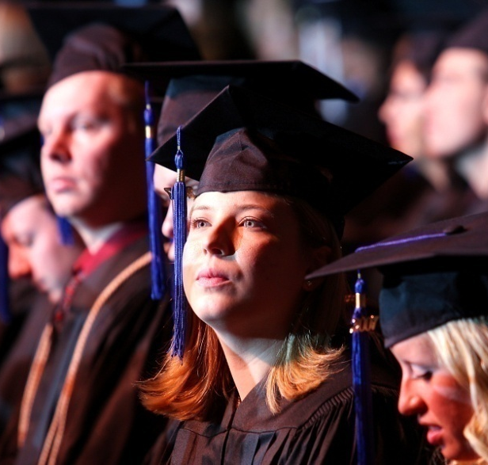
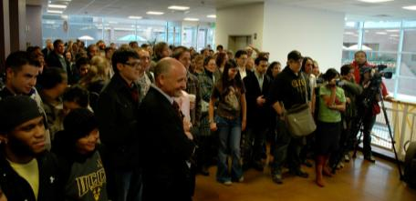
December
Commencement
Safety is a right rally
Regional college cooperation
Southern Colorado Innovation Strategy
Barbara Lorch remembered
Notes:
December commencement at Pikes Peak Center (year 2)
Safety is a right rally shows support for multiple races and orientations
Regional colleges – four year and two year – present jointly to CCHE
SCIS unveiled to joint meeting of Chamber and EDC
Barbara Lorch of sociology died Dec. 16. Memorial services were Jan. 22

Slide 9
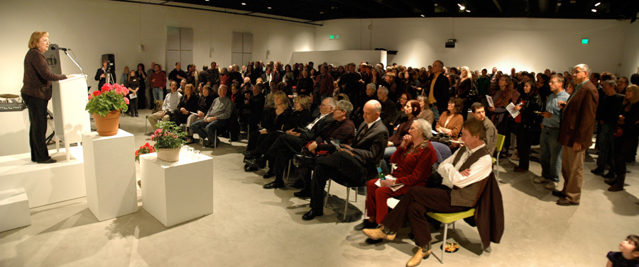


January
Beth-El and Lamar join forces
“Turn Me Off” campaign
LEED Gold certified
University District
Operation 6035
Gerry Riggs
remembered
Notes:
Beth-el and Lamar Community College join forces to “grow your own” rural health care workers with 100K Johnson Foundation grant
Turn me off is part of campaign of utility savings
University District
Operation 6035
Gerry Riggs dies Jan. 4

Slide 10
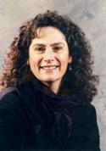
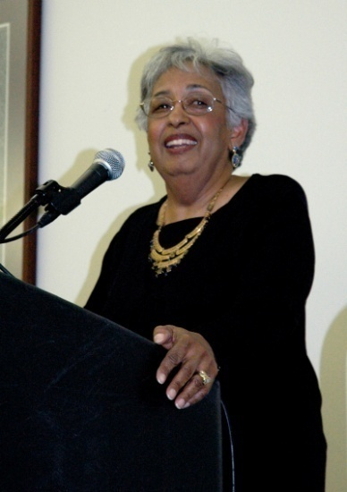
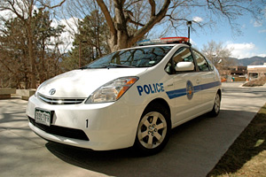
February
Spring enrollment record
Black History Month
Police opt for Prius
Gee Award winner
Beth-El downtown clinic
Staff learn to sign
Bulletin goes on-line
Notes:
Spring Enrollment is 7693, up 5%
Black History Month brings Nancy Todd Noches whose mother was plaintiff in Brown v. Board
Police Department replaces aging SUVS with 40 mpg Prius
Andrea Herrera wins Elizabeth Gee Award
Beth El opens downtown clinic with City of CS for wellness, reduction of health care costs
Staff members take ASL to communicate with other staff, community members
Bulletin goes on-line – elimination of 300 page printed document supports sustainablity as usability by students

Slide 11
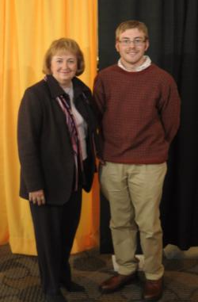
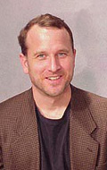
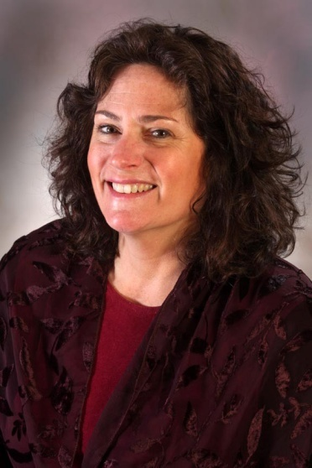
March
$5.5 million anonymous gift
Thomas Jefferson Award
Mountain Lion Research Day
Presidential Teaching
Notes:
5.5 gift is largest anonymous gift in CU history
TJ Award goes to Dec. 2008 grad Raymond Shultz
Mountain Lion Research Day showcases faculty, student work
Presidential Teaching Awards go to Herrera, Harvey

Slide 12
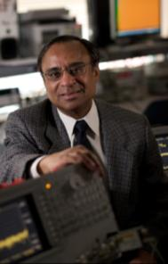
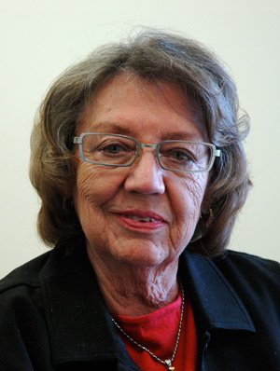
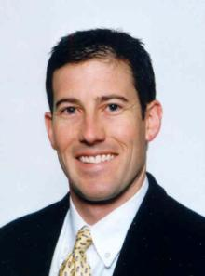
April
R. “Dan” Dandapani
Brian Winkelbauer
Budget forecasts
U.S. News graduate rankings
AD Kirkham does double duty
Ombuds Office

Slide 13
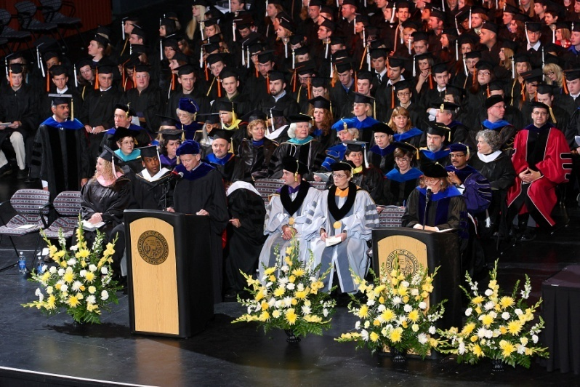
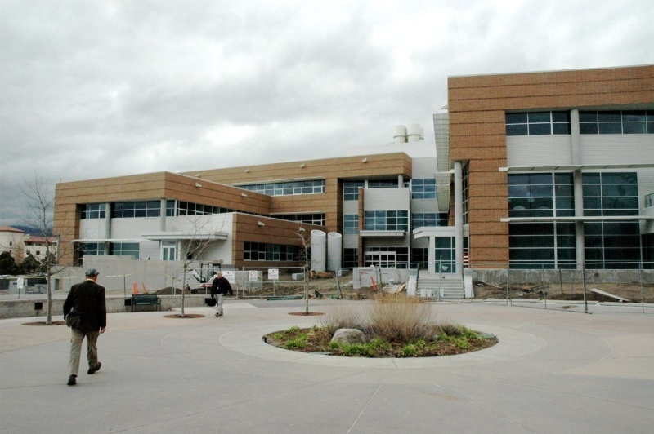
May
Budget forums
Campus Award
Ceremony
Commencement
August 6

Slide 14


