Slide 1
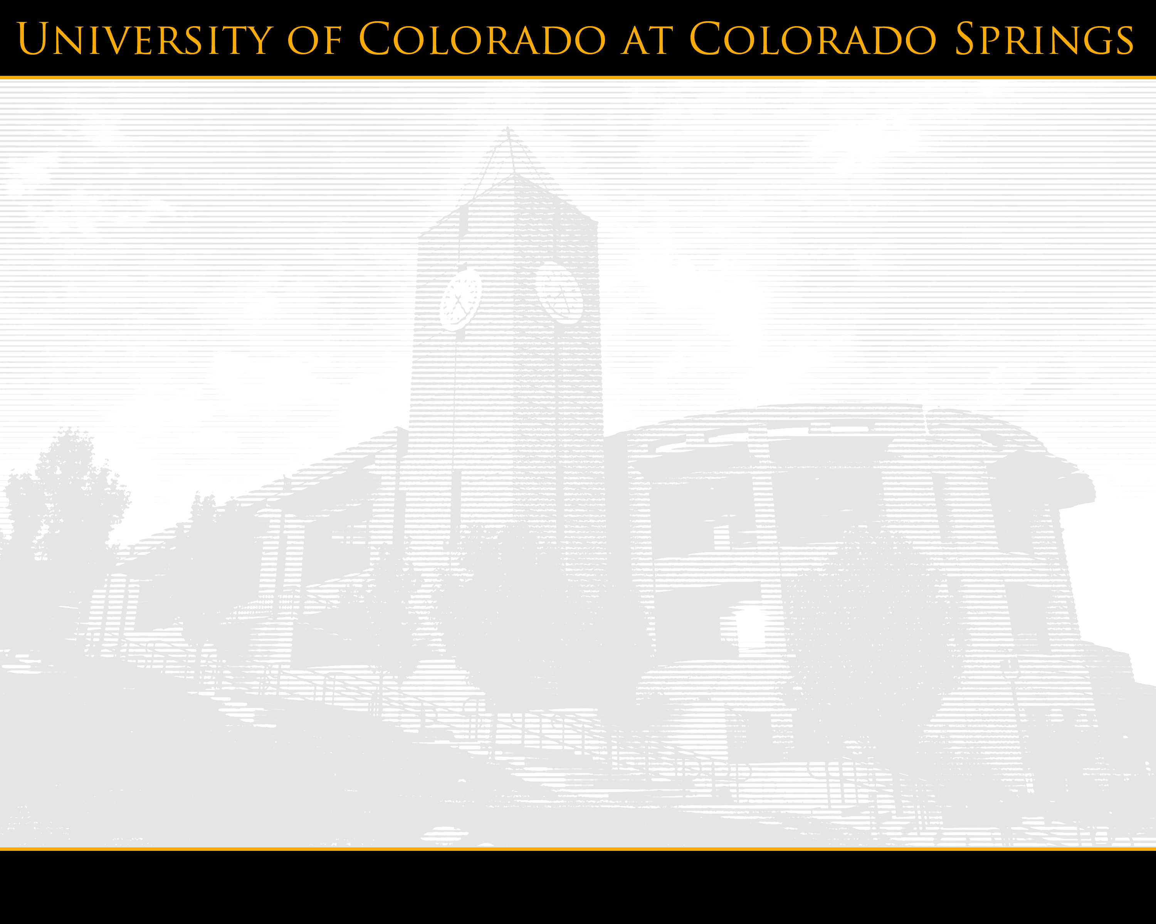

UCCS
Moving Forward
Chancellor Pam Shockley-Zalabak
CU Board of Regents
June 23, 2009

Slide 2
Topics
Historic Perspective
Southern Colorado Innovation Strategy
Southern Colorado Collaboratory
Research Efforts
Financial Planning

Slide 3
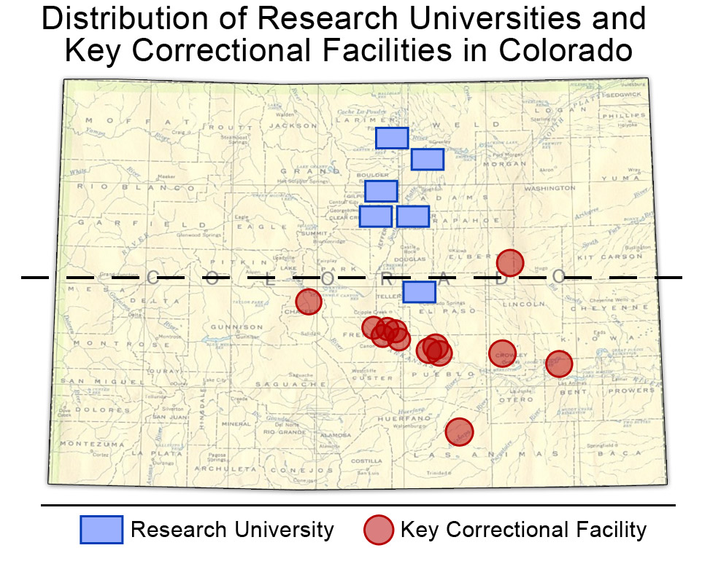
Historic Perspective
Notes:
Red dots indicate major state and federal prison facilities.

Slide 4
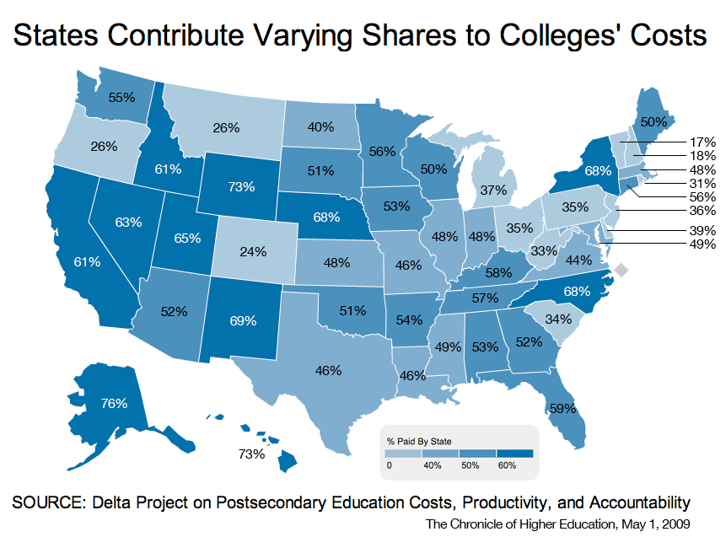
Historic Perspective

Slide 5
SCIS
Southern Colorado Innovation Strategy
  December presentation in Colorado Springs
  Collaboration among UCCS, state colleges, southern Colorado community colleges
  Joint presentation to CCHE, meetings in Pueblo

Slide 6
Goals
Southern Colorado Collaboratory
Access
Transfer
Technology
K-12 links
Marketing

Slide 7
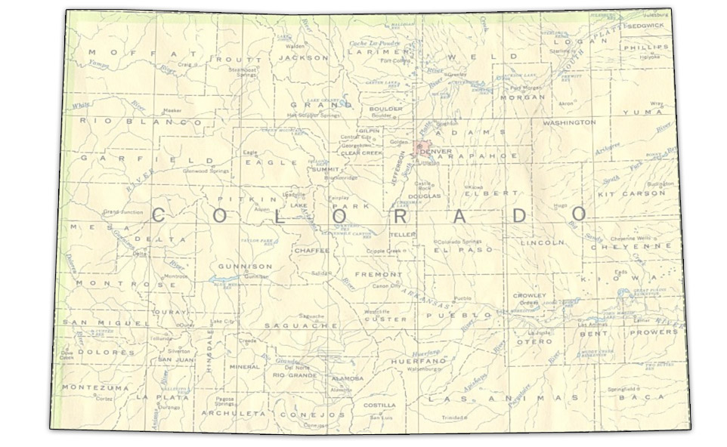
Southern Colorado Collaboratory

Slide 8
Awards
Research Efforts
Greg Plett, Engineering, $750,000 UM/GM Advanced Battery Coalition (funded)
Research Experiences for Undergraduates site for artificial intelligence (recommended)
Nanoparticle research (recommended)

Slide 9
State of Colorado
Research Efforts
Southern Colorado broadband expansion
Southern Colorado college access funding
Smart grid technology (cyber security)
Engineering wing renovation/energy improvements

Slide 10
National Institutes of Health
Research Efforts
Scientific equipment for academic and research laboratories
South Hall
Innovative interventions to prevent partner violence
Electronic alcohol social support network
Genetic regulation of hypoxia tolerance in humans (joint w/UCD)

Slide 11
National Science Foundation
Research Efforts
Infrastructure for artificial intelligence
Participation in computing for middle and high school girls
Chemistry curriculum improvement
Biology curriculum improvement
Translational oxide electronics technology (Araujo, Kalkur)

Slide 12
Research Efforts
Department of Education
  College access
  Family Development Center
Department of Energy
  Vehicle battery controls
  Transportation electrification (w/CU Boulder)
Department of Justice
  Byrne Grant

Slide 13
Research Efforts
Health and Human Services
  Child, youth and families
State of Colorado Council for the Arts
  Theatreworks
  Gallery for Contemporary Art
Department of Commerce
  North Nevada strategic planning grant
  Renovation of 3650 N. Nevada as incubator
  Scientific/Engineering equipment

Slide 14
Leadership
Financial Planning
University Budget Advisory Committee
Governance group involvement
Deans, directors

Slide 15
Financial Planning
Budget Strategy 2009-2012
Address cliff effect ²
Revise strategic plan
  Increase efficiencies
  Change structures
  Initiate revenue enhancements
  Involve regents, president, campus

Slide 16
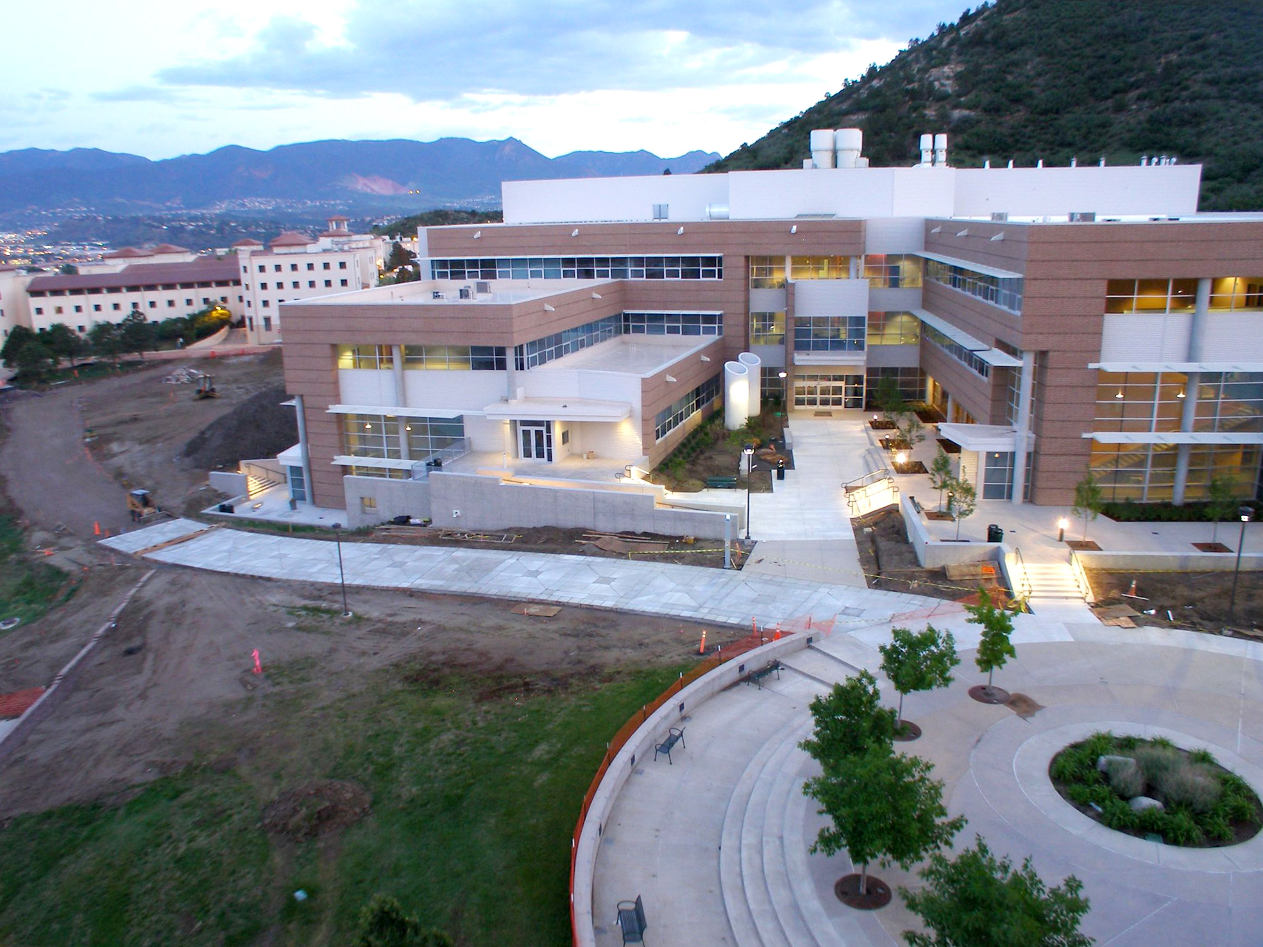
A Special Invitation
Aug. 6, 2009
Science and Engineering Dedication Ceremony

Slide 17
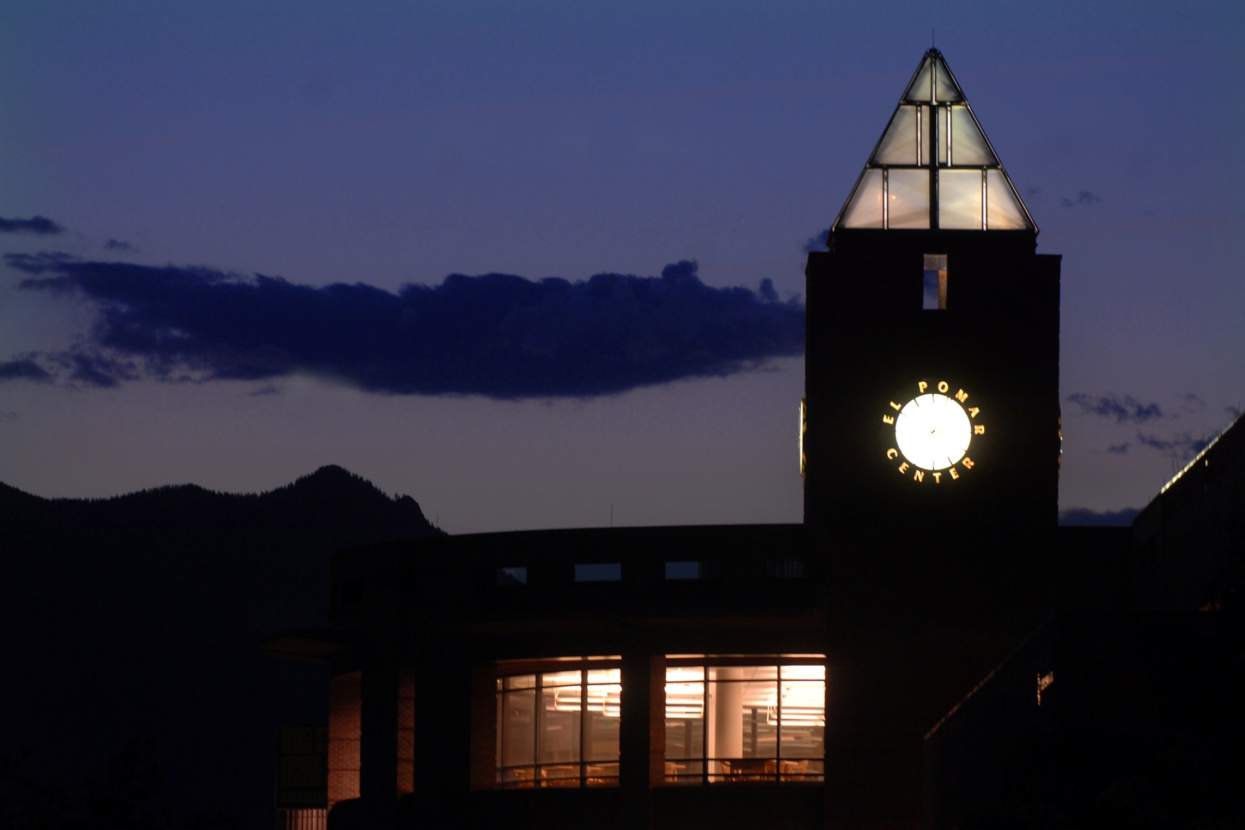
Shaping Lives
Creating Opportunity
Inventing the Future

Slide 18


