Slide 1
May Budget Update
Chancellor Pam Shockley-Zalabak
May 5, 2009

Slide 2
Review
Forums in February
Key Points
Planning for budget began in summer 2008
Steps underway for FY09-10
Met obligation of $686,718 state support cuts without unit reductions

Slide 3
Current Funds Budget History
Review

Slide 4
Update
State, regional, national economies deteriorating, unemployment rising
Colorado General Fund was $300 million “short” for FY 2009-10
Proposed Solutions
Workers Compensation Authority (Pinnacol)
or
$300 million reduction in state higher education funding

Slide 5
Decisions
Reduce state funding to CU by $49,995,467 ($150 million total to higher ed)
UCCS share = $4,932,495 (est.)
General Assembly distributes cuts relatively equitably
Governor Ritter opts to use federal stimulus funds to backfill in FY09-10, FY10-11
How this looks graphically…

Slide 6
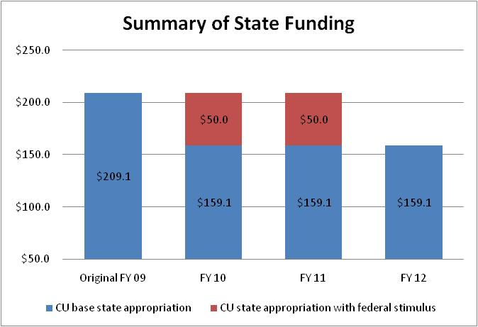
Summary of State Funding – CU System

Slide 7
UCCS State Funding: The Cliff Effect
Federal
Stimulus Funding

Slide 8
Outlook
State economy not expected to recover to restore $4,932,495 by end of FY 2010-11

Slide 9
The Preliminary Plan 2009-2011
$1.8 million in spending reductions
Improve processes and efficiency
Review enrollment targets and tuition rates
Build multi-faceted strategy by end of 2009 to deal with “cliff” effect
Net increase of $4 million in revenues over two years

Slide 10
Plan FY 2009-10
Current State Appropriated Funds $22,941,600
Total Cuts 21.5% (4,932,495)
Proposed State Funds 2009-10 $18,009,105

Slide 11
Plan FY 2009-10
Expenditure Reductions
ICCA Reduction $431,034
Operating Increase not released 145,674
Reduce Campus benefit surplus 50,000
Increase GAR 50,000
Chancellor 50,000
Salary Sweep (2 mos) 125,000
IT 100,000
Student Success 150,000
Admin & Finance 150,000
Advancement 40,000
Academic Affairs 600,000
Subtotal Expenditure Reductions $1,891,708

Slide 12
Plan FY 2009-10
Revenue Increase
Tuition Increase (est. 2.6%) $947,031
Federal Stimulus Funds 2,093,756
Expenditure Reductions 1,891,708
Total Planned Strategies $4,932,495

Slide 13
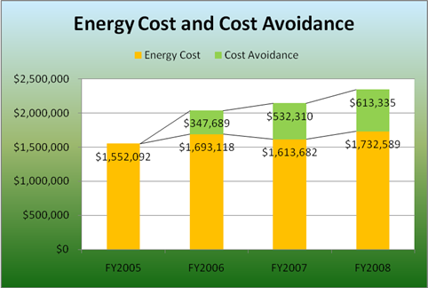
Process and Efficiency

Slide 14
Assigned Holidays
2009-10
Veterans Day assigned to Dec. 24, 2009
Presidents Day assigned to Dec. 31, 2009
2010-11
Veterans Day assigned to Dec. 27, 2010
Presidents Day assigned to Jan. 3, 2011
Energy saved by closing buildings vs. spreading holidays throughout the year

Slide 15
Enrollment and Revenue Enhancements Net increase of $4 million over 2 years

Slide 16
Issues of Concern
Furloughs
Do not appear to apply to higher education
Layoffs
Not planned at present
Benefits
90% of market to be maintained
Benefit holiday may be used to reduce rate increases, which are still unknown

